Slide 1
Building chatbots with MS Bot Framework
Form Flows

Slide 2
Copy the files from here
https://github.com/code-monster-kevin/chatbot-102/tree/basic-form-1

Slide 3
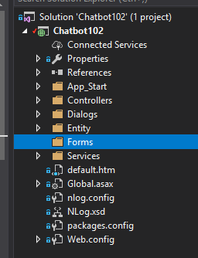
Add a new folder called “Forms”

Slide 4
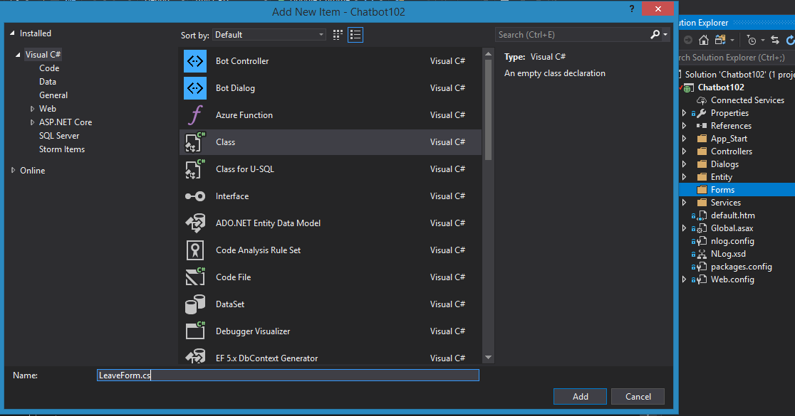
Create a new class “LeaveForm.cs”

Slide 5
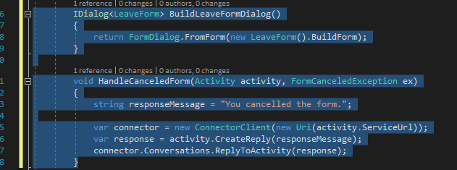
Add code in MessagesController.cs to build the form into a dialog and to handle cancel form event

Slide 6
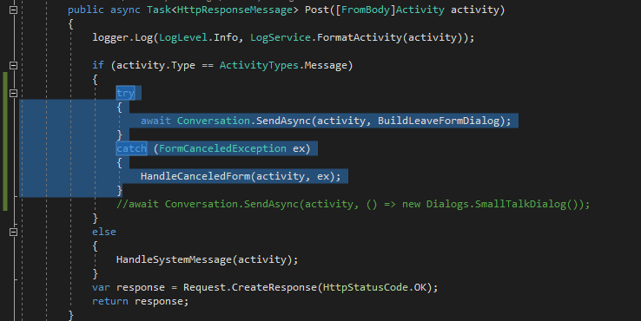
Add code to call the form dialog

Slide 7
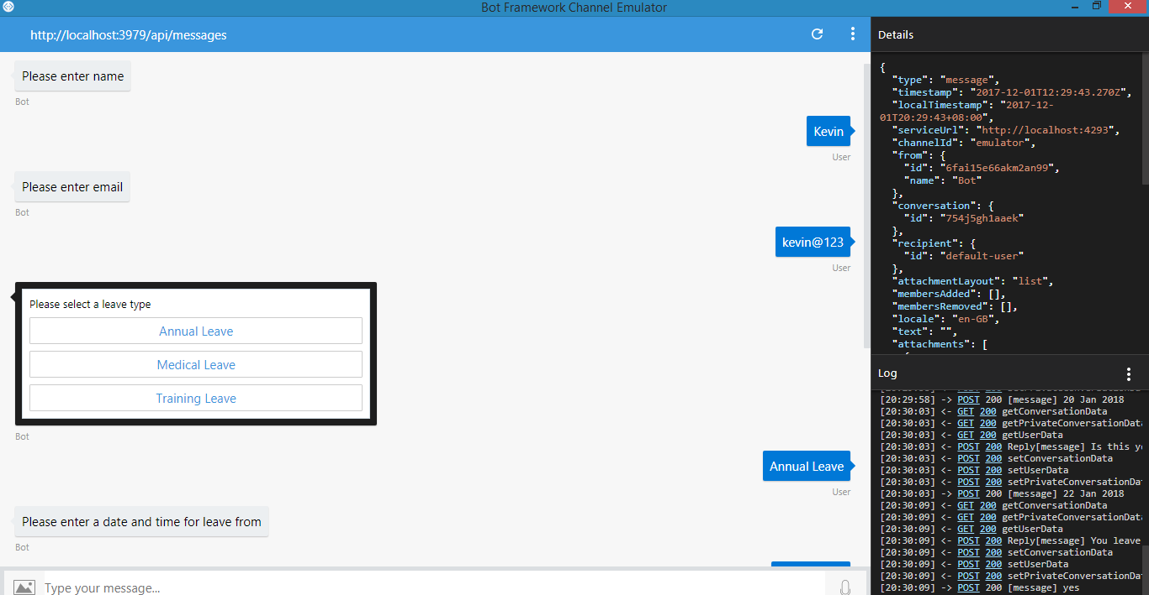
Run the application!

Slide 8
Copy the files from here
https://github.com/code-monster-kevin/chatbot-102/tree/better-form-1

Slide 9
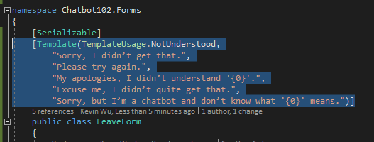
TemplateUsage
https://docs.microsoft.com/en-us/dotnet/api/microsoft.bot.builder.formflow.templateusage

Slide 10
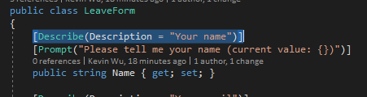
Describe
https://docs.microsoft.com/en-us/dotnet/api/microsoft.bot.builder.formflow.describeattribute

Slide 11
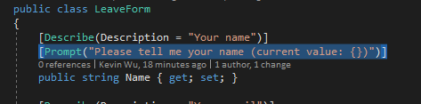
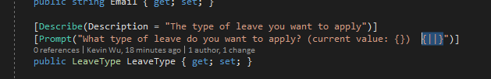
Prompt
https://docs.microsoft.com/en-us/dotnet/api/microsoft.bot.builder.formflow.promptattribute

Slide 12

Pattern attribute
Regular expression for validating the content of a string field
https://docs.microsoft.com/en-us/dotnet/api/microsoft.bot.builder.formflow.patternattribute

Slide 13
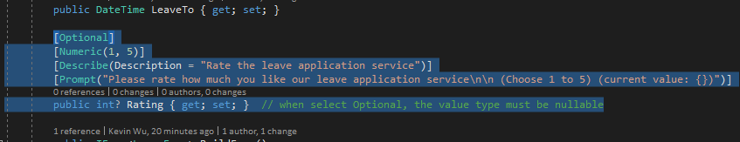
Optional, Numeric…etc
https://docs.microsoft.com/en-us/dotnet/api/microsoft.bot.builder.formflow.optionalattribute
https://docs.microsoft.com/en-us/dotnet/api/microsoft.bot.builder.formflow.numericattribute

Slide 14
Run the application again…

